Slide 1
Lecture 27
Mobile Application Model or Architecture

Slide 2
Clients
There are many mobile device types, including RIM devices, cellular telephones, PDAs, Tablet
PCs, and Laptop PCs.
These mobile devices can typically operate as thin clients or fat clients, or they can be developed so that they can host web pages.

Slide 3
Thin Clients
Thin clients have no custom application code and completely rely on the server for their functionality.
They do not depend as heavily on the mobile device’s operating system or the mobile device type as fat clients.
Thin clients typically use widely available web and Wireless Application Protocol (WAP) browsers to display application content pages.

Slide 4
Thin clients

Slide 5
Fat clients
Fat clients typically have one to three layers of application code on them and can operate independently from a server for some period of time.
Typically, fat clients are most useful in situations where communication between a client and server cannot be guaranteed.
For example, a fat client application may be able to accept user input and store data in a local database until connectivity with the server is re-established and the data can be moved to the server.
This allows a user to continue working even if he/she is out of contact with the server.

Slide 6
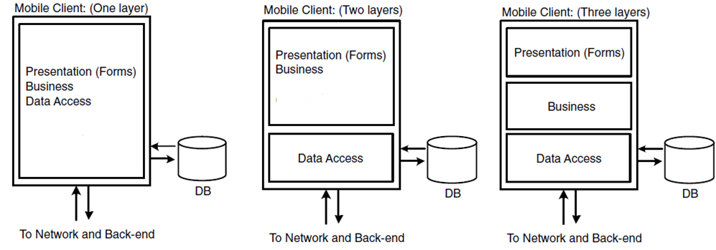
Fat Client

Slide 7
Web page Hosting
It is possible to display web pages on the mobile device even when the mobile client is only periodically connected to the network and back-end systems.
In order to do so, we need the equivalent of a “mini” web server on the mobile device.

Slide 8
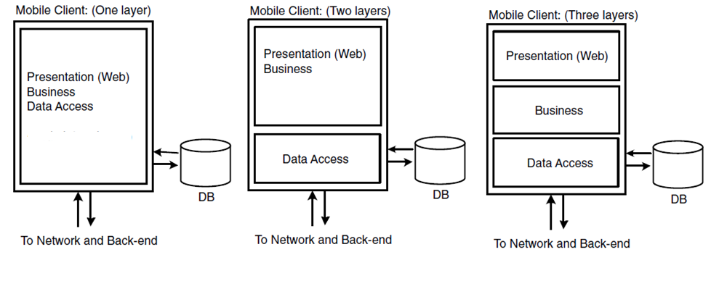
Web Page hosting

Slide 9
Servers
Server architectures are commonly composed of one to three code layers implemented in one to three tiers.

Slide 10
One-Tier Server architecture

Slide 11
Two-Tiers Server architecture

Slide 12
Three-Tiers Server architecture

Slide 13
Connection Types
Mobile devices typically operate in one of three modes:
Partially connected
Never connected
Always connected

Slide 14
Synchronization
The connection type affects the way in which you can synchronize data between the mobile device and back-end systems.
Synchronization is possible in two ways: continuously or through a store-and-forward method

Slide 15
Continuous Communication
When the connectivity between the client and server is continuous, the synchronization of data between client and server is continuous and can be achieved through synchronous or asynchronous means

Slide 16
Continuous Communication

Slide 17
Store and Forward Synchronization
When connectivity between a client and server cannot be guaranteed, it is still possible to store and transmit information safely using a method called “store-and-forward.”
Suppose, for example, that a mobile user wishes to enter data while his/her mobile device is not connected to a server. A mobile client application can initially store the data in a local data .
Later, when a connection has been established, the mobile application will forward the data from the local database to the database on the server

Slide 18
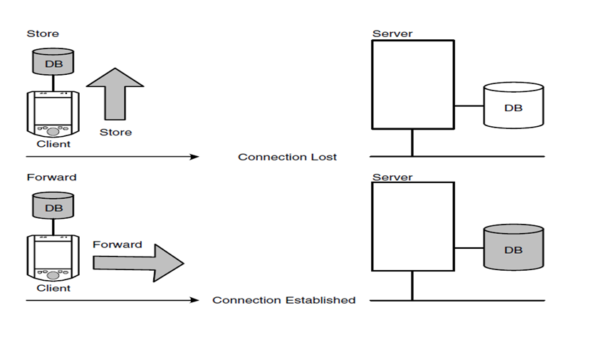
Store and Forward Synchronization

